Slide 1
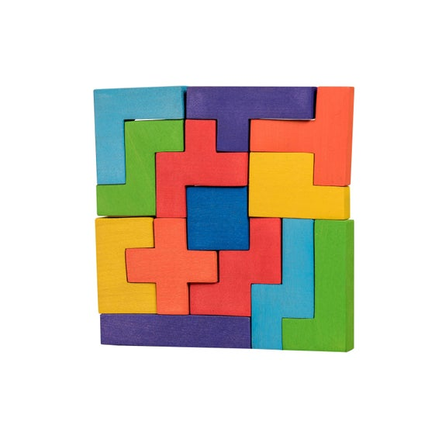
Block Puzzle
Data Structures, 2020 Spring, EECS, NTHU

Slide 2
Descriptions
This will be a useful tool for you to solve block puzzles
There will be 12 test cases
10 for basic requirements
2 for bonus

Slide 3
Input
number of pieces
3
4 2
OOOO
-O--
2 3
O-
OO
OO
3 3
-OO
OO-
O--
2
4 6
----
--OO
--OO
----
O--O
O-OO
5 4
-----
O----
O--O-
OO---
English char,
Big ‘O’
the "exact" width and height of the piece
1st piece
shape
Minus
No need to handle
pathetic pieces, e.g.,
2nd piece
3 3
---
-OO
-O-
3 2
---
---
0 2
3rd piece
number of puzzle maps
width and height
1st puzzle map
2nd puzzle map

Slide 4
Operations for Matching Basic Requirement
Each piece should be used exactly once for each map
Output
Is it possible to complete the map?
Yes
No

Slide 5
Bonus
Only the last two of the testing data have these cases

Slide 6
Operations for Matching Bonus
Rotating and flipping the pieces are allowed

Slide 7
Input
number of pieces
3
4 2
OOOO
-O--
2 3
O-
OO
OO
3 3
-OO
OO-
O--
2
4 6
OOOO
----
O---
O---
O---
OO--
5 4
-----
O----
O--O-
OO---
English char,
Big ‘O’
the "exact" width and height of the piece
1st piece
shape
Minus
No need to handle
pathetic pieces, e.g.,
2nd piece
3 3
---
-OO
-O-
3 2
---
---
0 2
3rd piece
number of puzzle maps
width and height
1st puzzle map
2nd puzzle map

Slide 8
Output
Is it possible to complete the map?
Yes
No

Slide 9
2nd Example
Input
5
4 2
OOOO
--O-
3 3
-OO
OO-
O--
5 1
OOOOO
1 4
O
O
O
O
3 3
-O-
OOO
--O
2
5 5
-----
-----
-----
-----
--O--
9 5
OOOO-OOOO
OOO---OOO
OO-----OO
O-------O
---------
Output
No
Yes

